Slide 1
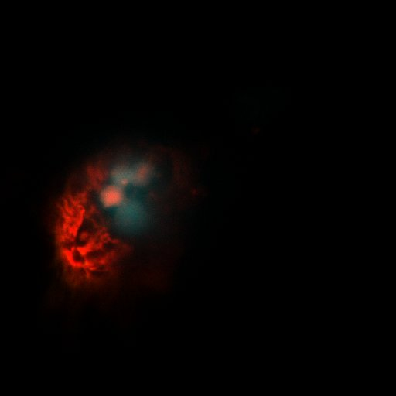
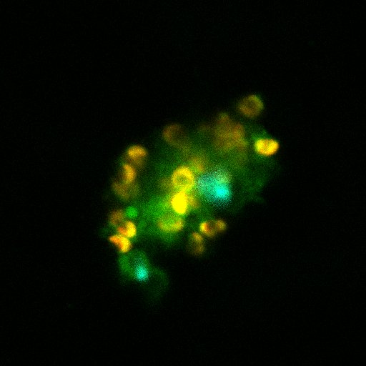
FISH – comparison of RW to culture probe hybridizes to the 28S of Teleaulax sequence: alexa 488 – AACACACGAGTTAAGATACCAATGGATCATTCACTCGCATGCCC
100x magnification. Lab culture (fed with Geminigera)
100x magnification. Red water sample from Baker Bay (BBS090512)

Slide 2
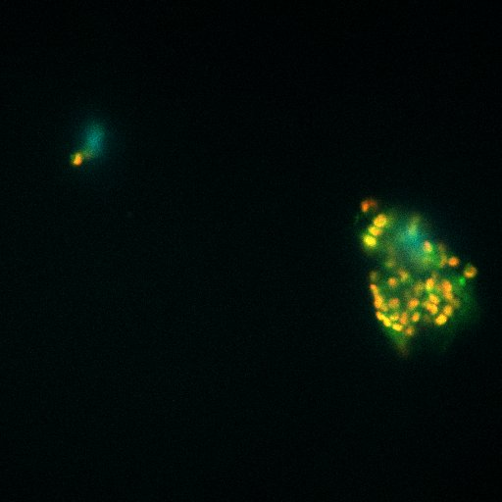
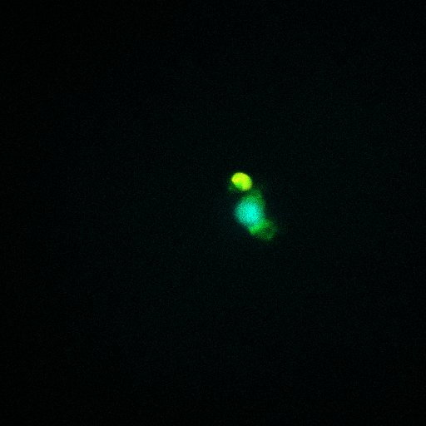
FISH – Tx probe, samples from Baker Bay RW (BBS090512)
40x magnification. Mesodinium and Teleaulax
100x magnification. Close up of Telaualax

Slide 3
QPCR data
All samples done in triplicate
Teleaulax – used Teleaulax 28S specific primers
Cryptophyte – used general cryptophyte 28S primers

Slide 4
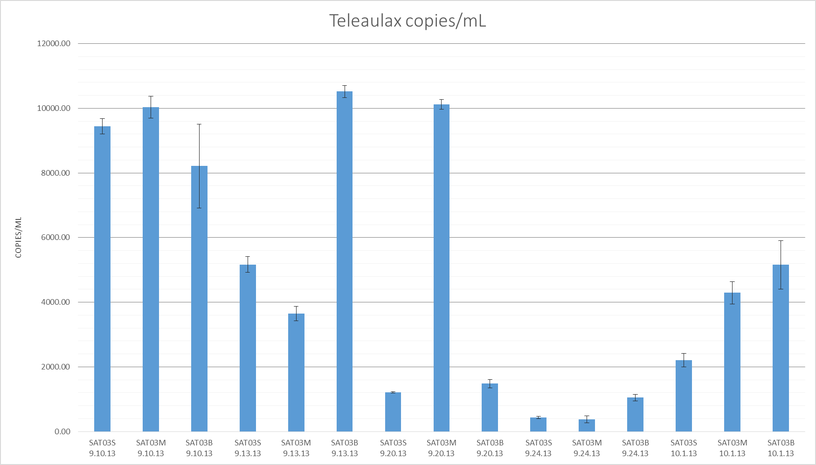

Slide 5
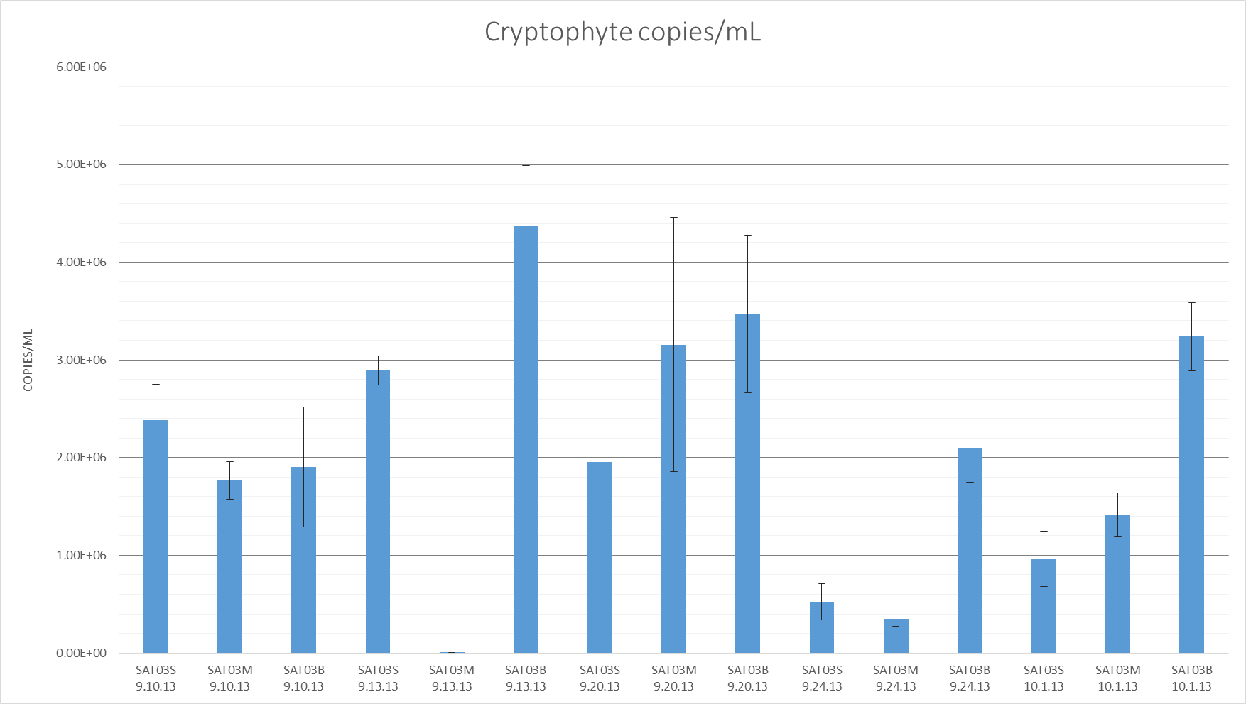

Slide 6
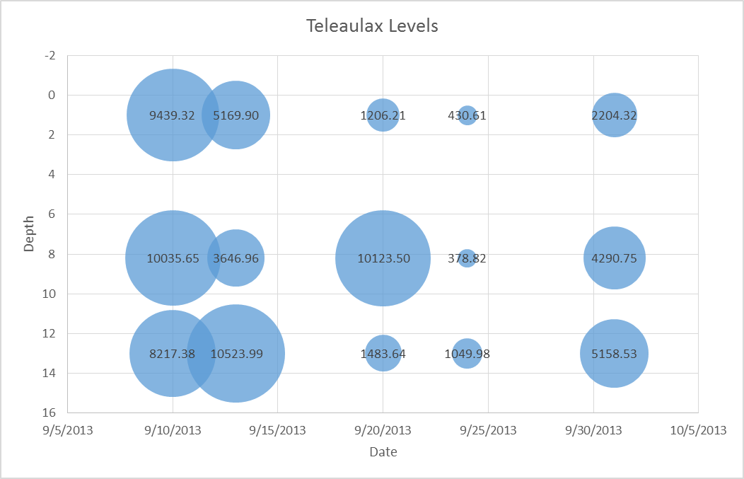
Teleaulax distribution depth vs time
Top: SAT03 surface
Mid: SAT03 mid depth
Bottom: SAT03 bottom depth
Bubble size: Teleaulax copies/mL

Slide 7
Sample Name | date | time | depth | Crp copies/ ml | crp stdev | tx copies/ ml | tx stdev | crp/tx | Sal
SAT03S 9.10.13 | 9/10/2013 | 9:51:00 | 1 | 2.38E+06 | 3.67E+05 | 9439.32 | 237.20 | 252.21 | 8.4
SAT03M 9.10.13 | 9/10/2013 | 10:00:00 | 8.2 | 1.76E+06 | 1.91E+05 | 10035.65 | 335.95 | 175.75 | 7.1
SAT03B 9.10.13 | 9/10/2013 | 10:06:00 | 13 | 1.90E+06 | 6.16E+05 | 8217.38 | 1299.08 | 231.78 | 17.8
SAT03S 9.13.13 | 9/13/2013 | 9:27:00 | 1 | 2.89E+06 | 1.49E+05 | 5169.90 | 237.91 | 559.82 | 11.2
SAT03M 9.13.13 | 9/13/2013 | 9:20:00 | 8.2 | 5.46E+03 | 2.18E+03 | 3646.96 | 222.17 | 1.50 | 21.8
SAT03B 9.13.13 | 9/13/2013 | 9:15:00 | 13 | 4.37E+06 | 6.22E+05 | 10523.99 | 187.41 | 414.79 | No Data
SAT03S 9.20.13 | 9/20/2013 | 14:20:00 | 1 | 1.96E+06 | 1.62E+05 | 1206.21 | 21.09 | 1621.52 | 29.9
SAT03M 9.20.13 | 9/20/2013 | 14:20:00 | 8.2 | 3.16E+06 | 1.30E+06 | 10123.50 | 151.36 | 311.68 | 30.2
SAT03B 9.20.13 | 9/20/2013 | 14:20:00 | 13 | 3.47E+06 | 8.07E+05 | 1483.64 | 128.36 | 2337.26 | 30.3
SAT03S 9.24.13 | 9/24/2013 | 15:34:00 | 1 | 5.25E+05 | 1.84E+05 | 430.61 | 39.22 | 1218.06 | 22.8
SAT03M 9.24.13 | 9/24/2013 | 15:28:00 | 8.2 | 3.48E+05 | 7.24E+04 | 378.82 | 108.23 | 917.46 | 23.0
SAT03B 9.24.13 | 9/24/2013 | 15:23:00 | 13 | 2.10E+06 | 3.48E+05 | 1049.98 | 103.09 | 1996.56 | 23.0
SAT03S 10.1.13 | 10/1/2013 | 11:40:00 | 1 | 9.66E+05 | 2.83E+05 | 2204.32 | 211.44 | 438.01 | 8.1
SAT03M 10.1.13 | 10/1/2013 | 11:45:00 | 8.2 | 1.42E+06 | 2.21E+05 | 4290.75 | 346.11 | 330.07 | 22.1
SAT03B 10.1.13 | 10/1/2013 | 11:50:00 | 13 | 3.24E+06 | 3.48E+05 | 5158.53 | 747.34 | 627.41 | 27.0

